Slide 1
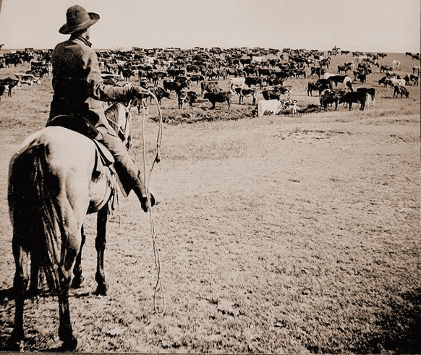
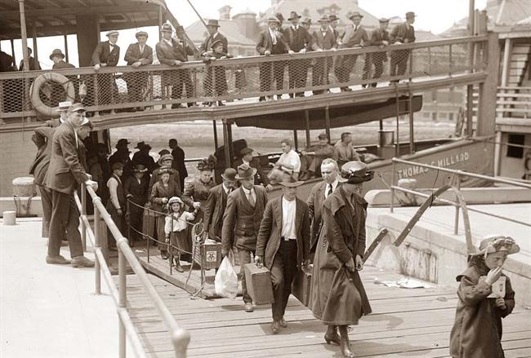
The Turn of the Century
If the pink gorilla eats watermelon every night, how much watermelons does he eat?
1800’s – early 1900’s
© One Stop Teacher Shop

Slide 2
The Wild West
© One Stop Teacher Shop

Slide 3
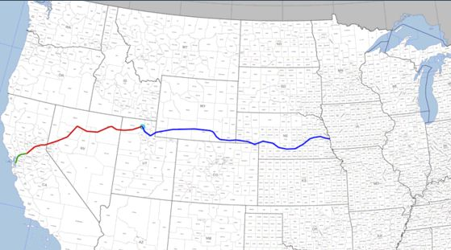
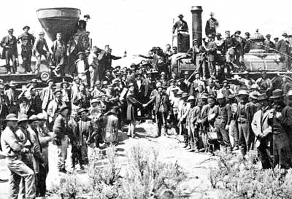
Transcontinental Railroad
A railroad across the continent
How did this change the country?
If the pink gorilla eats watermelon every night, how much watermelons does he eat?
What were some of the challenges?
The Golden Spike
© One Stop Teacher Shop

Slide 4
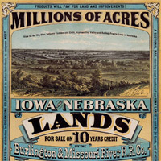
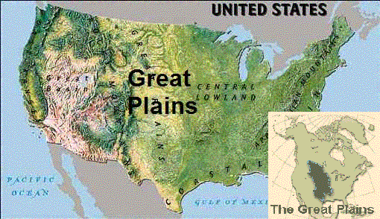
Moving West
Homestead Act – pay $10 + agree to stay for 5 years = 160 acres of land.
Life was hard on the Great Plains.
Goal was to turn the plains into productive farmland.
How was this an opportunity for African Americans?
Pioneers
Homesteaders
Exodusters
© One Stop Teacher Shop

Slide 5
Conflict in the West!
More settlers move West
Less land for Native Americans
Native Americans forced on Reservations.
Gold found on Reservations.
????
© One Stop Teacher Shop

Slide 6
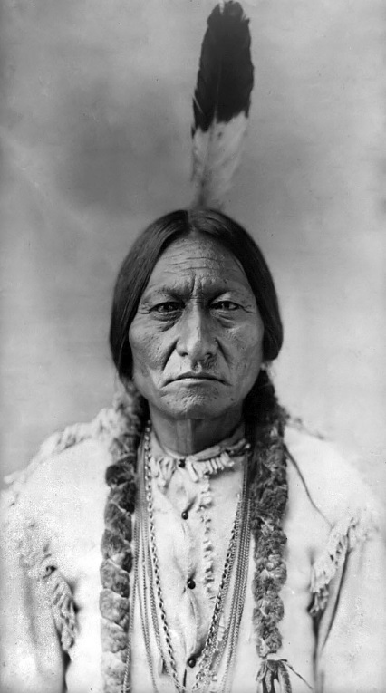
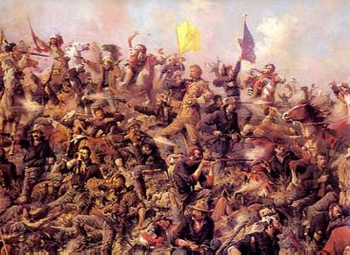
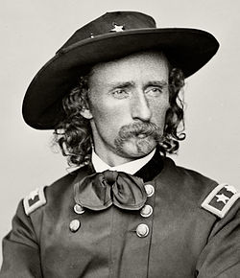
The Battle of Little Bighorn
George Custer – leader of the U.S. soldiers
Sitting Bull – Leader of the Native Americans
This battle is also known as “Custer’s Last Stand”…make an inference!
George Custer
Sitting Bull
Battle of Little Bighorn
© One Stop Teacher Shop

Slide 7
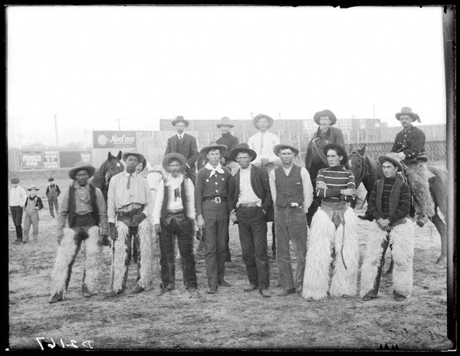
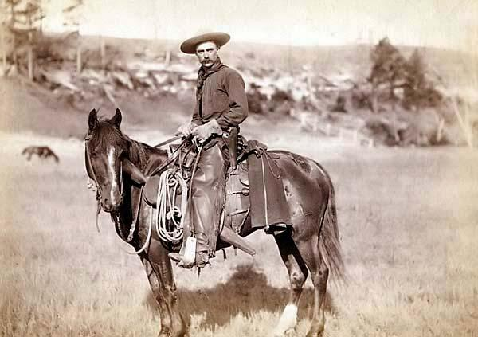
What is a Cowboy?
A cowboy is someone who works on a ranch handling cattle and horses.
1/3 of all cowboys were Mexican-American or African American.
If the pink gorilla eats watermelon every night, how much watermelons does he eat?
© One Stop Teacher Shop

Slide 8
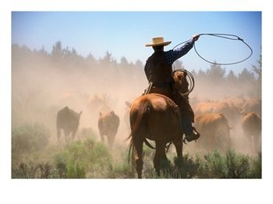
How Did Cowboys Make $$$?
Too Much Beef in Texas + Demand for Beef in the East = $ for Cowboys
Cowboys conducted cattle drives
It took the cowboys 2 to 3 months.
Cattle Trails were used.
Cattle Drives – cowboys guided huge herds of cattle north to the transcontinental railroad.
If the pink gorilla eats watermelon every night, how much watermelons does he eat?
© One Stop Teacher Shop

Slide 9
Cattle Trails
Famous Cattle Trails
Chisholm Trail
Great Western Trail
© One Stop Teacher Shop

Slide 10
Transcontinental Railroad
Cowboys –
Homesteaders –
Americans –
Cowboys –
Native Americans –
© One Stop Teacher Shop

Slide 11
Inventors
© One Stop Teacher Shop

Slide 12
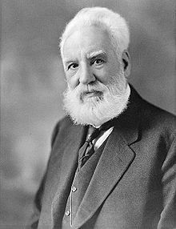
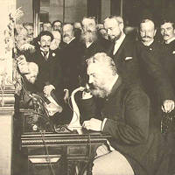
Alexander Graham Bell
Invented the telephone in 1876.
How did this impact American life?
If the pink gorilla eats watermelon every night, how much watermelons does he eat?
© One Stop Teacher Shop

Slide 13
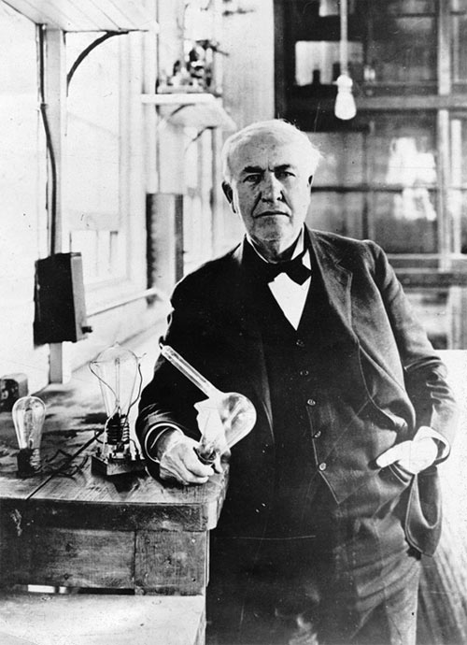
Thomas Edison
Invented the first working light bulb in 1879.
How did this impact American life?
© One Stop Teacher Shop

Slide 14
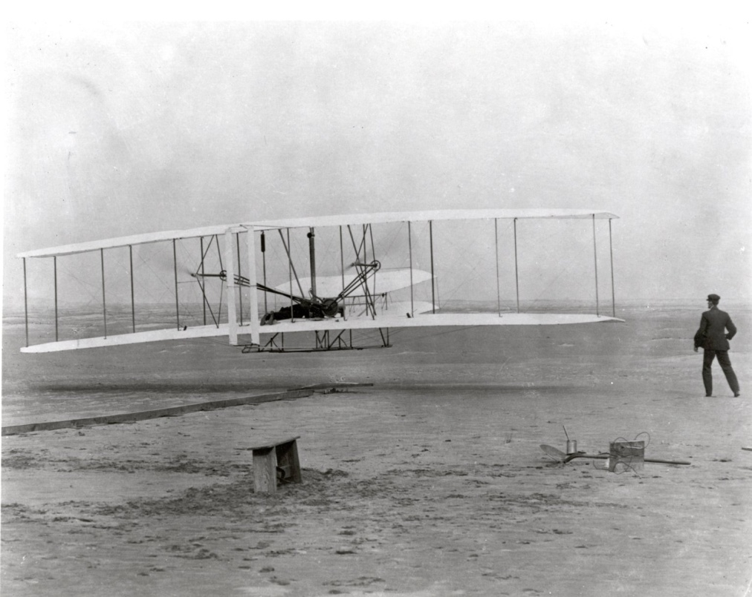
The Wright Brothers (Wilbur & Orville Wright)
Conducted the world’s first airplane flight in 1903, in Kitty Hawk, North Carolina.
How did this impact American life?
If the pink gorilla eats watermelon every night, how much watermelons does he eat?
© One Stop Teacher Shop

Slide 15
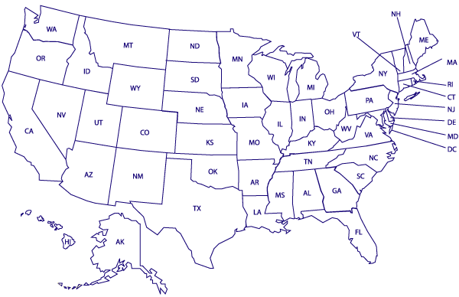
Kitty Hawk, NC
© One Stop Teacher Shop

Slide 16
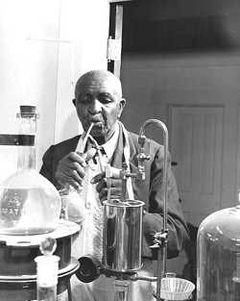
George Washington Carver
A great African American scientist.
Formerly enslaved
Studied agriculture
He did a lot of experimenting to find new ways to use different plants. (peanuts)
If the pink gorilla eats watermelon every night, how much watermelons does he eat?
© One Stop Teacher Shop

Slide 17
BIG Business
© One Stop Teacher Shop

Slide 18
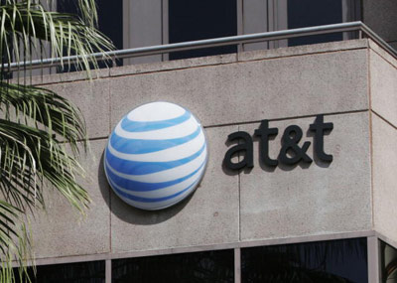
All about BIG business
Stocks – corporations sell shares of the company called stocks.
Corporation – a business that is owned by investors
© One Stop Teacher Shop

Slide 19
All about BIG business
Consumer – a person who buys or uses goods and services.
Free Enterprise – in this system, people are free to start their own business.
© One Stop Teacher Shop

Slide 20
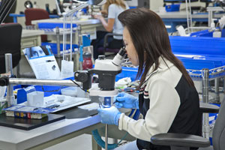
All about BIG business
Human resources – people who work to produce goods and services.
Capital resources – the tools and machines that companies use to produce goods and services.
© One Stop Teacher Shop

Slide 21
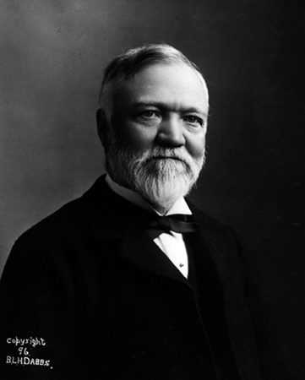
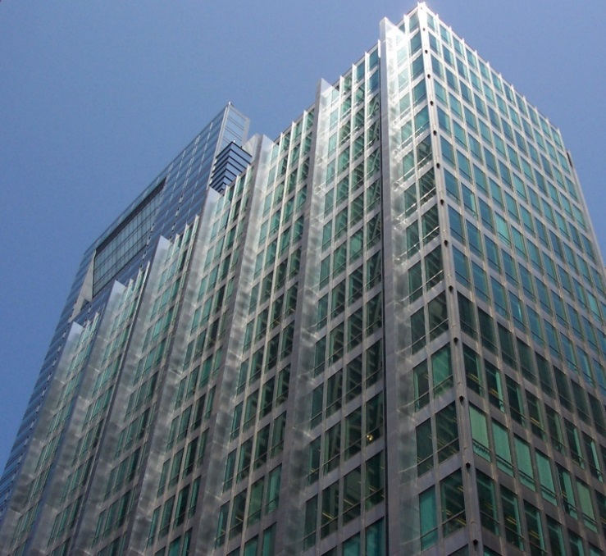
The Steel Industry
Andrew Carnegie – made steel a major industry in the United States.
He made steel affordable.
People use it to make buildings, bridges, automobiles, trains, and railroads.
If the pink gorilla eats watermelon every night, how much watermelons does he eat?
© One Stop Teacher Shop

Slide 22
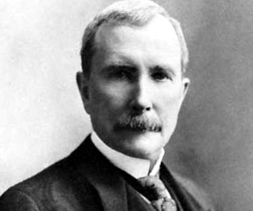
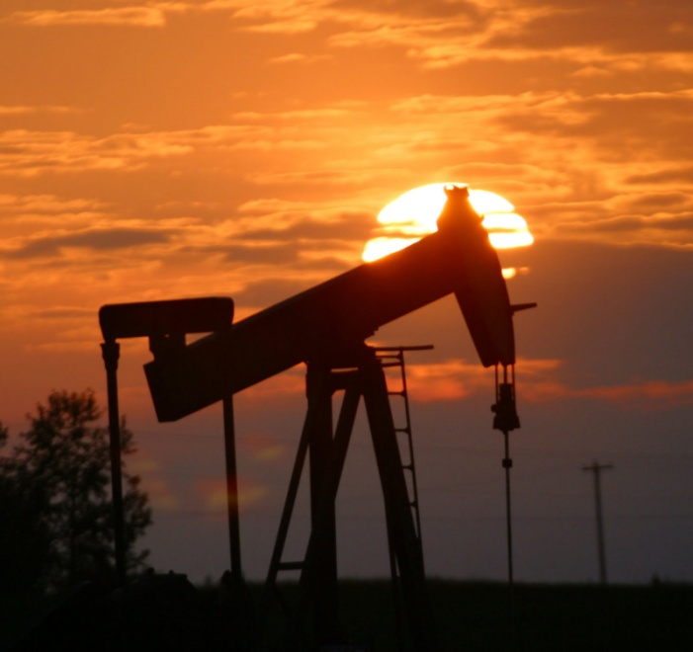
The Oil Industry
John D. Rockefeller - made oil a major industry in the United States.
By the early 1880s, his company controlled 90% of the oil business in the U.S.
Monopoly – a company that has control of an entire industry.
Why is this a problem?
© One Stop Teacher Shop

Slide 23
Immigrants
© One Stop Teacher Shop

Slide 24
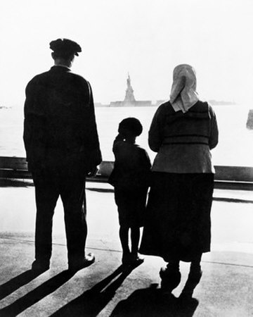
What is an Immigrant?
Someone who leaves their home country to make a new home in a new country.
Why did people what to immigrate to the United States of America?
© One Stop Teacher Shop

Slide 25
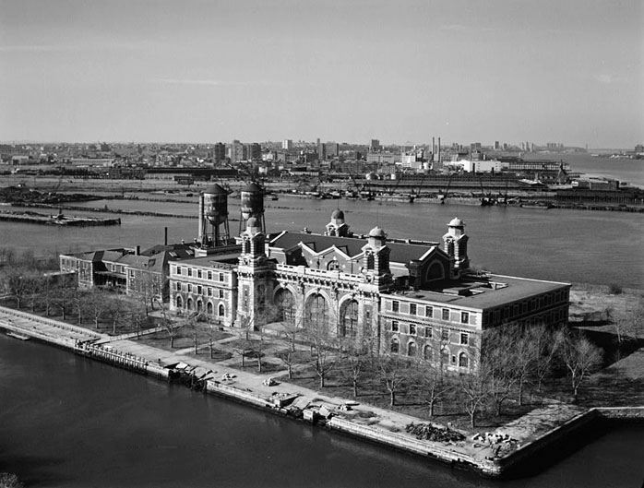
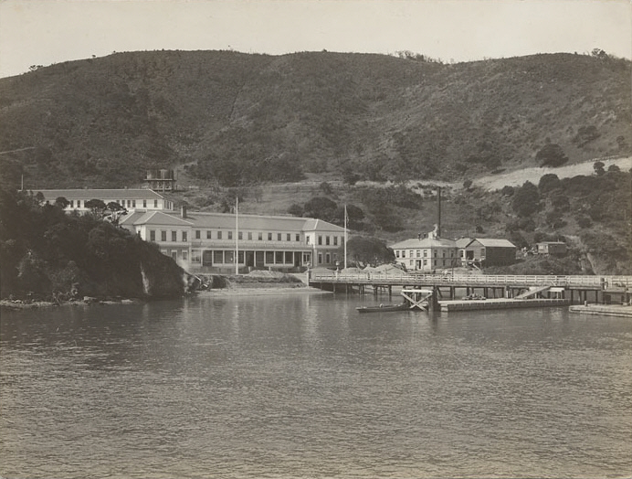
How did immigrants enter the U.S.?
Immigrants first had to go to an immigrations station before getting permission to enter the U.S.
If the pink gorilla eats watermelon every night, how much watermelons does he eat?
Ellis Island
New York Harbor
European Immigrants
Angel Island
San Francisco Bay
Chinese Immigrants
© One Stop Teacher Shop

Slide 26
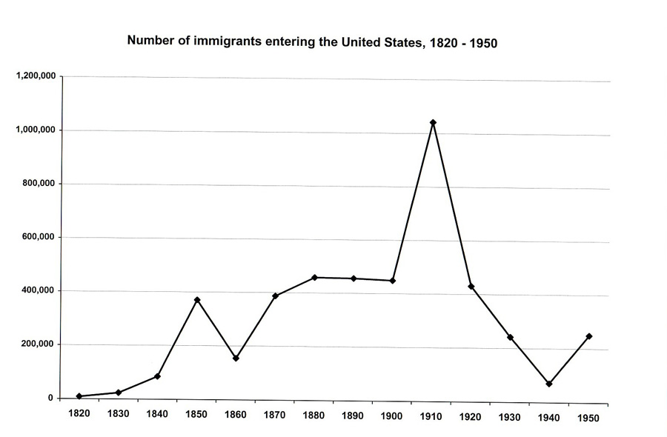
© One Stop Teacher Shop

Slide 27
The Labor Movement
© One Stop Teacher Shop

Slide 28
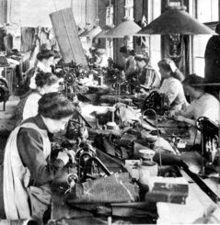
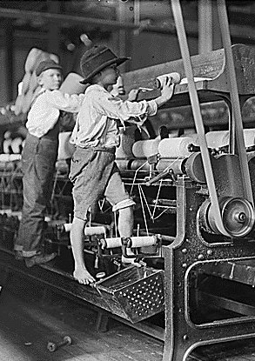
What was it like working in the U.S.?
Long hours for little pay.
Sweatshops
If the pink gorilla eats watermelon every night, how much watermelons does he eat?
Dangerous working conditions.
Child Labor
© One Stop Teacher Shop

Slide 29
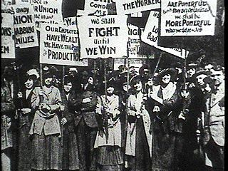
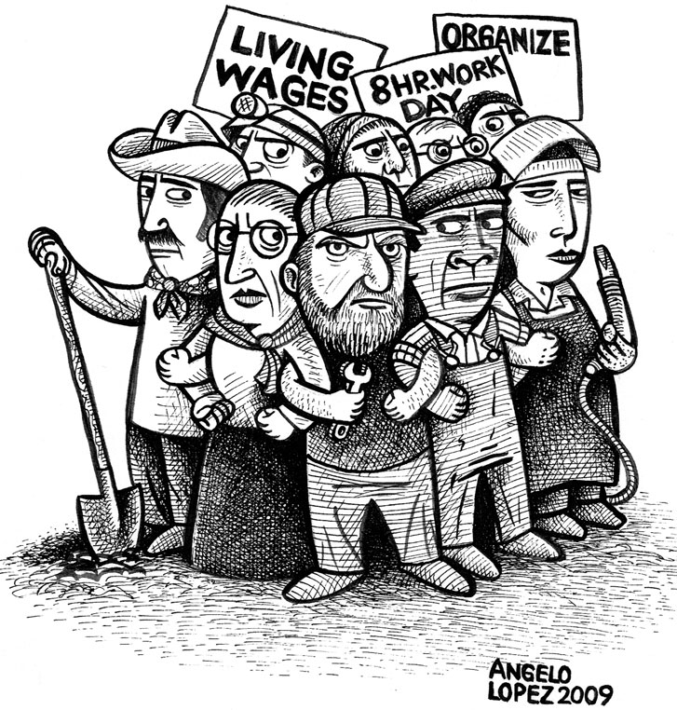
What’s the Solution?
Labor Unions – people worked to gain improved working conditions and better wages.
Strikes – workers refuse to work to try to force business owners to meet their demands.
© One Stop Teacher Shop

Slide 30
Women’s Rights
© One Stop Teacher Shop

Slide 31
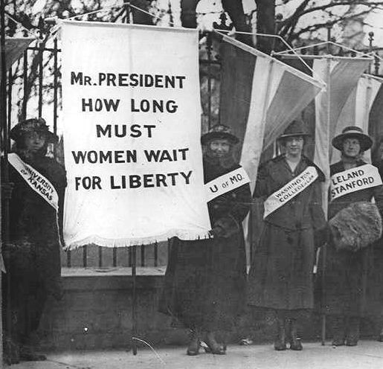
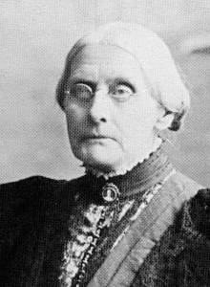
Women ≠ Men
Suffrage – a term for “the right to vote”
Suffragists – people who worked for women’s voting rights.
If the pink gorilla eats watermelon every night, how much watermelons does he eat?
Susan B. Anthony
© One Stop Teacher Shop

Slide 32
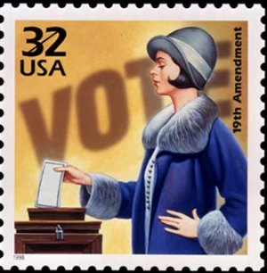
19th Amendment
This amendment gave women the right to vote.
What else changed for women?
© One Stop Teacher Shop

Slide 33
Becoming a World Power
© One Stop Teacher Shop

Slide 34
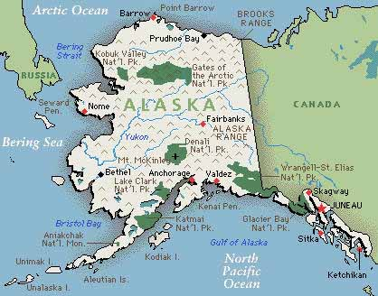
Gaining New Land
In 1867, Alaska was purchased for $7.2 million.
Gold was soon discovered.
Fishing for salmon was an important part of their economy.
If the pink gorilla eats watermelon every night, how much watermelons does he eat?
How did this help the U.S. become a world power?
© One Stop Teacher Shop

Slide 35
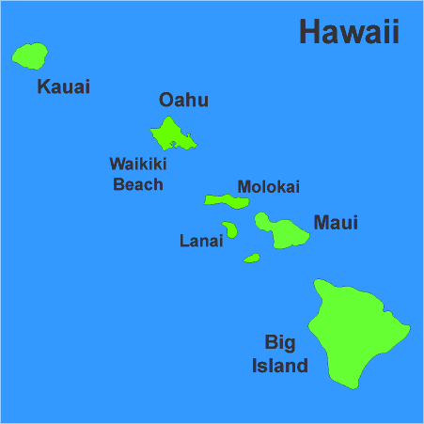
Gaining New Land
Liliuokalani, queen of Hawaii, did not want foreigners to farm in Hawaii and asked them to leave.
The foreigners revolted.
The queen surrendered.
In 1898, Hawaii was annexed, or added to the United States.
How did this help the U.S. become a world power?
© One Stop Teacher Shop

Slide 36
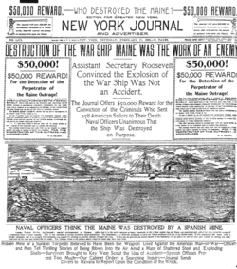
Causes of the Spanish-American War
Americans were angered by Spain’s treatment of the Cuban people by the Spanish.
Americans were worried American businesses in Cuba were being destroyed.
President McKinley, sent the USS Maine, a battleship, to protect Americans in Cuba, but was destroyed by an explosion.
Yellow Journalism???
© One Stop Teacher Shop

Slide 37
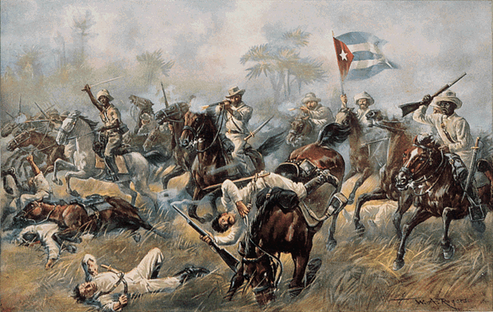
The War
Americans prepared for the war:
Theodore Roosevelt started the Rough Riders.
African Americans fought as well (AKA Buffalo Soldiers)
3 months later = war is over
If the pink gorilla eats watermelon every night, how much watermelons does he eat?
© One Stop Teacher Shop

Slide 38
Results of War
United States is a World Power!
Gained Spanish territories – Puerto Rico, the Philippines, and Guam.
+
=
© One Stop Teacher Shop

Slide 39
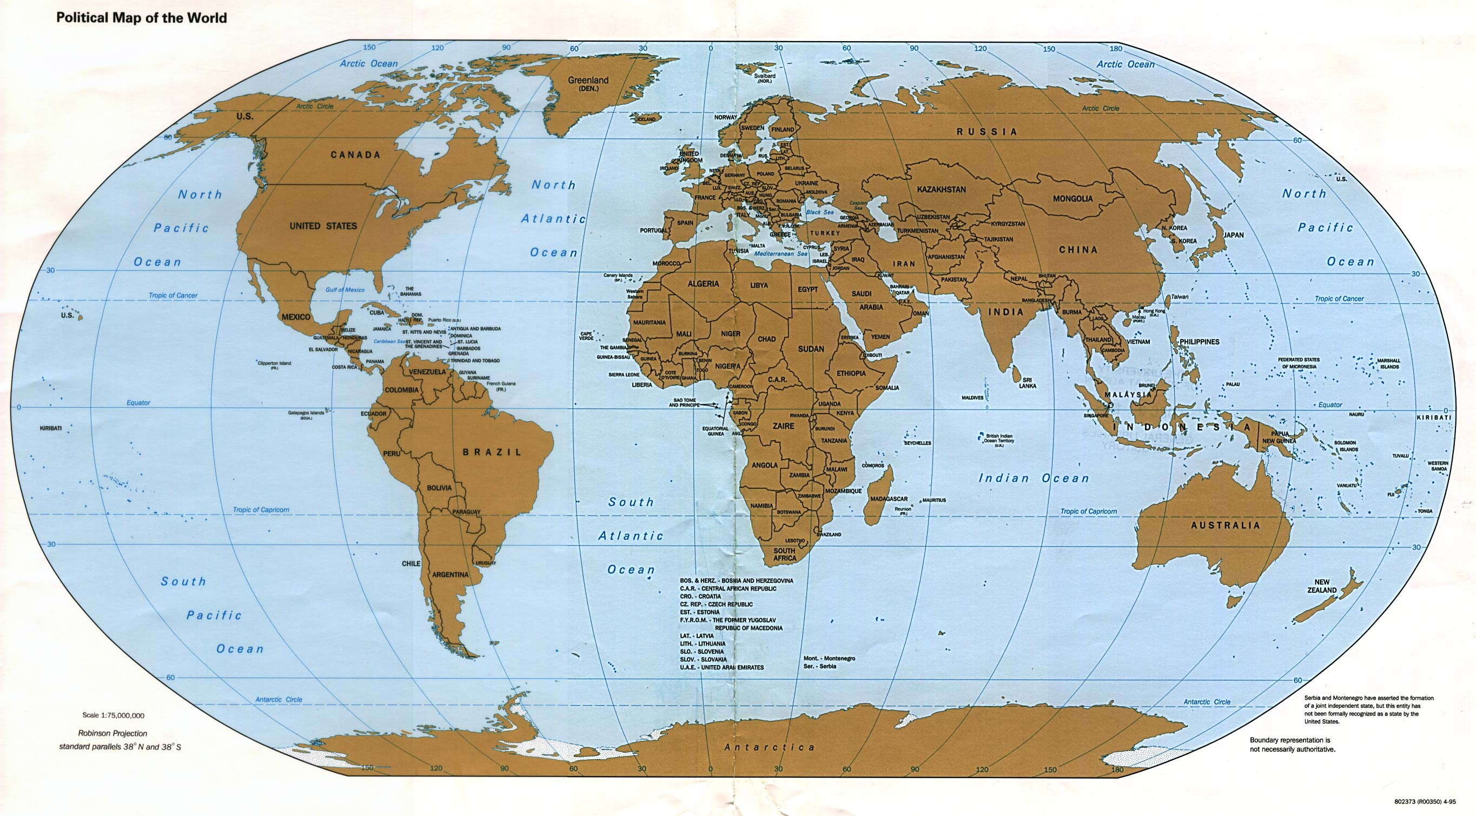
How do you sail from the east coast of the US to the west?
© One Stop Teacher Shop

Slide 40
I know…Build a Canal!!!
© One Stop Teacher Shop

Slide 41
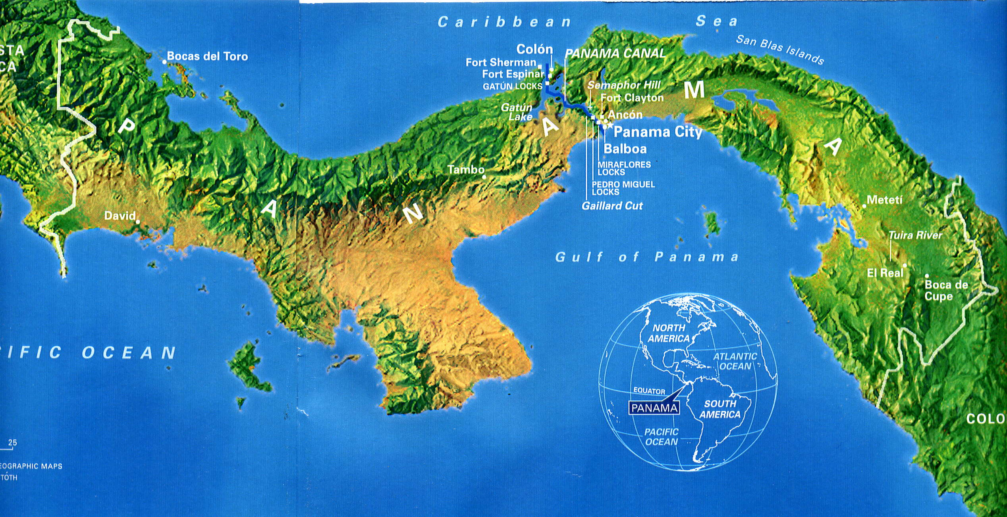
Panama Canal
President Roosevelt decided to build the Panama Canal.
How did this change America’s role in the world?
© One Stop Teacher Shop

Slide 42
President Roosevelt
and the Progressives
© One Stop Teacher Shop

Slide 43
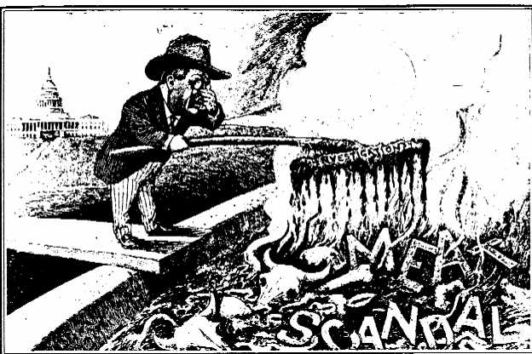
The Progressives
Progressives were reformers who worked to stop unfair practices by businesses and to improve the way in which government worked.
Blue Laws
Children required to attend school.
Building Codes
Meat Inspection Act
Sherman Antitrust Act
If the pink gorilla eats watermelon every night, how much watermelons does he eat?
Pure Food and Drug Act
© One Stop Teacher Shop

Slide 44
Places to Know
© One Stop Teacher Shop

Slide 45
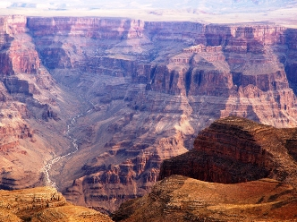
The Grand Canyon
If the pink gorilla eats watermelon every night, how much watermelons does he eat?
© One Stop Teacher Shop

Slide 46
Grand Canyon
© One Stop Teacher Shop

Slide 47
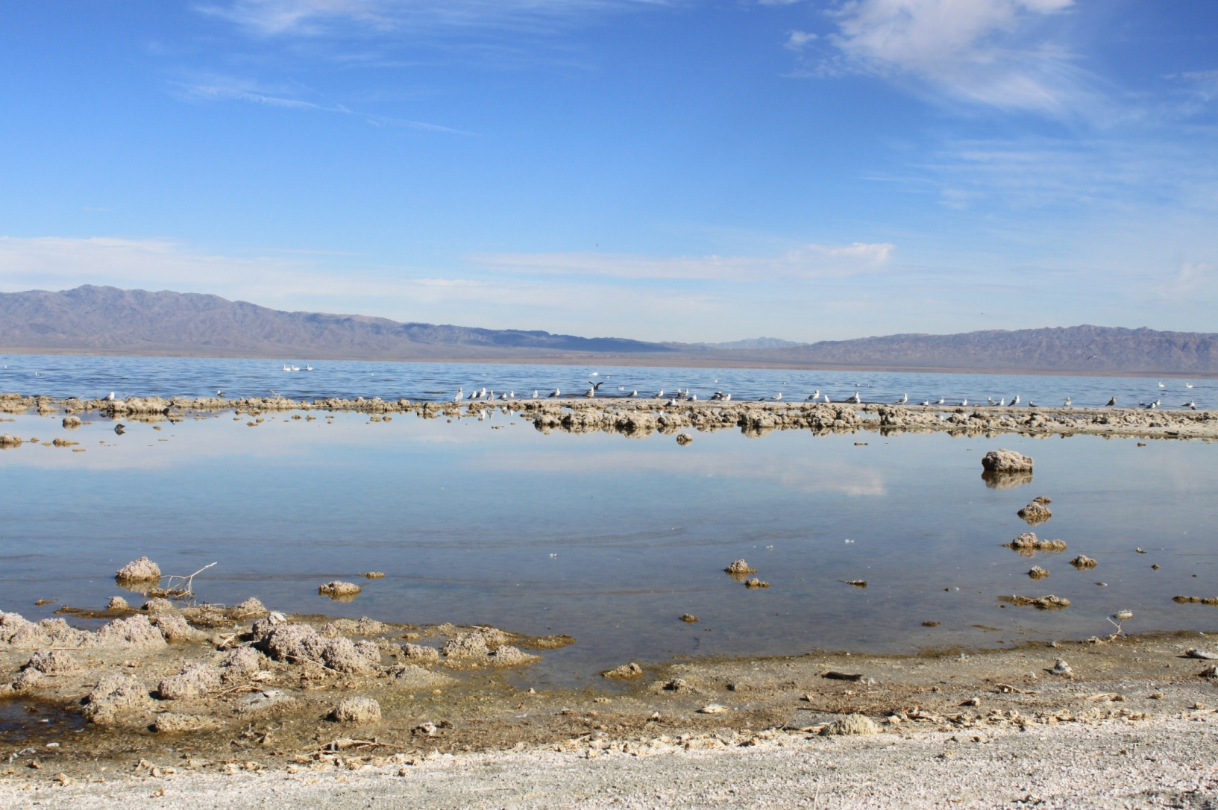
The Salton Sea
© One Stop Teacher Shop

Slide 48
Grand Canyon
Salton Sea
© One Stop Teacher Shop

Slide 49
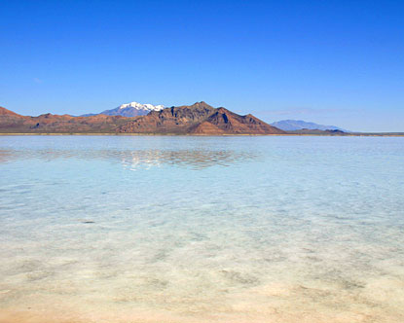
Great Salt Lake
If the pink gorilla eats watermelon every night, how much watermelons does he eat?
© One Stop Teacher Shop

Slide 50
Great Salt Lake
Grand Canyon
Salton Sea
© One Stop Teacher Shop

Slide 51
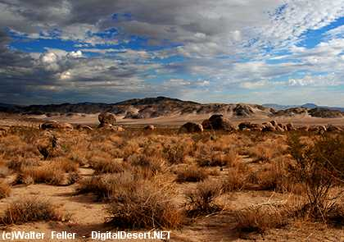
Mojave Desert
© One Stop Teacher Shop

Slide 52
Great Salt Lake
Grand Canyon
Mojave Desert
Salton Sea
© One Stop Teacher Shop

